Slide 1

Pdas ca1
By: Adam bin roslan

Slide 2
Topic questions
Does humidity and rainfall affect the number of different diseases in Singapore?
“If so , how does humidity and rainfall impact the spread of diseases in Singapore?”

Slide 3



Urls of my datasets from data.gov
https://beta.data.gov.sg/collections/476/view
https://beta.data.gov.sg/collections/1398/view
https://beta.data.gov.sg/collections/1404/view

Slide 4
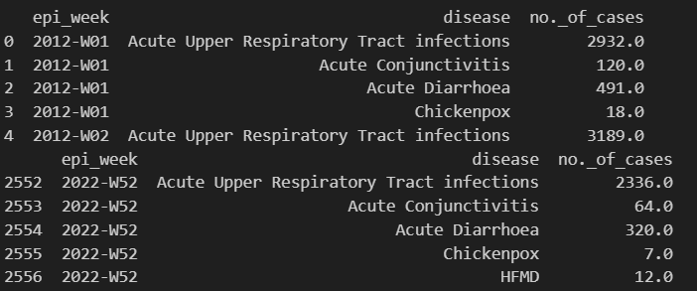
#1 dataset: AverageDailyPolyclinicAttendancesforSelectedDiseases.csv
I used df.head and df.tail to get the information that I needed by showing the start and end of the dataset.
Epi_week This column represents the epidemiological week of a particular year. An epidemiological week is a standardized method of counting weeks to allow for the comparison of data year after year. The year starts from 2012 and ends at 2022 which indicates that the dataset covers a span of about 10 years.
Disease: This column lists the diseases that were reported in the given epidemiological week. The diseases listed in the image include ‘Acute Upper Respiratory Tract infections’, ‘Acute Conjunctivitis’, ‘Chickenpox’, and ‘HFMD’ (Hand, Foot, and Mouth Disease).
No. of Cases: This column indicates the number of reported cases for each disease in the corresponding epidemiological week. The numbers in this column represent the count of cases.

Slide 5
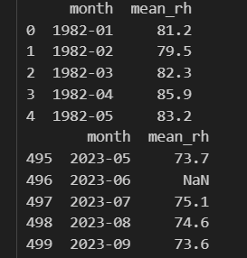
#2 dataset: RelativeHumidityMonthlyMean.csv
I used df.head and df.tail to get the information that I needed by showing the start and end of the dataset.
Month: This column represents the mean relative humidity for each month from 1982 to 2023
Mean Relative Humidity (mean_rh): This column represents the average relative humidity for each of the corresponding month. Relative humidity is a measure of the amount of moisture in the air compared to the maximum amount of moisture the air could hold at the same temperature. The values are likely in percentage due to their decimal points (1dp).

Slide 6
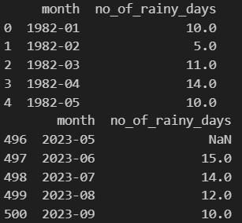
#3 dataset: RainfallMonthlyNumberofRainDays.csv
I used df.head and df.tail to get the information that I needed by showing the start and end of the dataset.
Month: This column represents the No. of rainy days for each month from 1982 to 2023 .
No. of Rainy Days: This column represents the number of rainy days for the corresponding month. This could be a count of the days in which the rainfall exceeded a certain threshold.

Slide 7



DATA PROCESSING AND ANALYSING

Slide 8
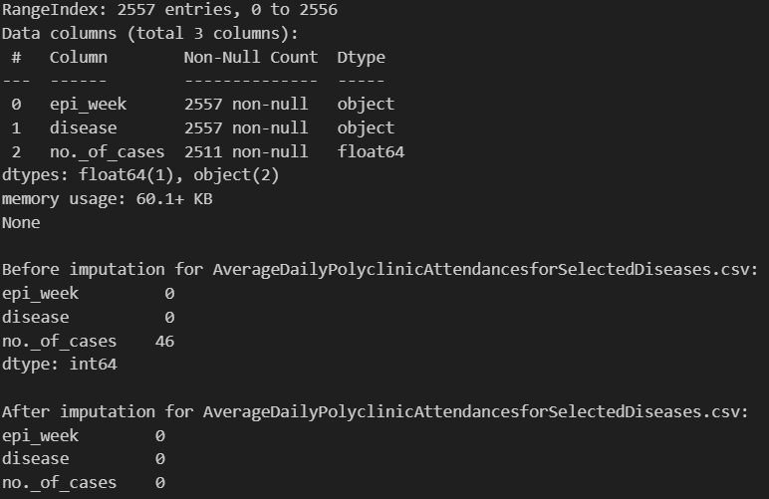
#1 DATA PROCESSING AND ANALYSING of AverageDailyPolyclinicAttendancesforSelectedDiseases.csv
The ‘epi_week’ and ‘disease’ columns have 2557 non-null entries while the no_of_cases have 2511 entries which indicates that there are 46 missing values in this column.
Therefore, I created a function that handles missing data values with the mean (average) of the column
It can be seen that after imputation, there are 0 missing values which shows that the dataset has been successfully imputated.

Slide 9
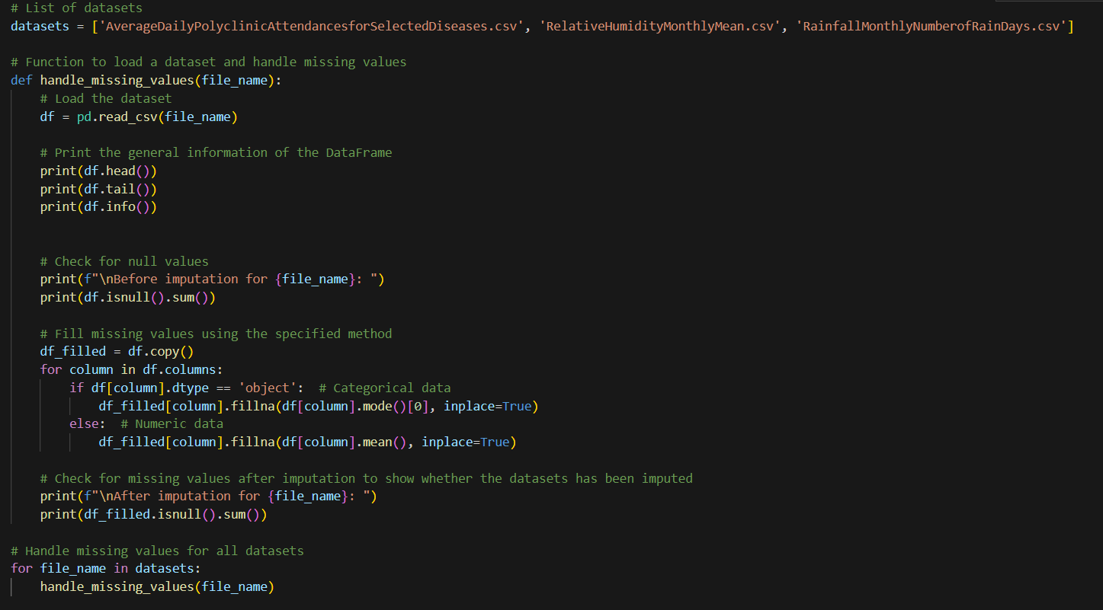
Function to handle missing data

Slide 10
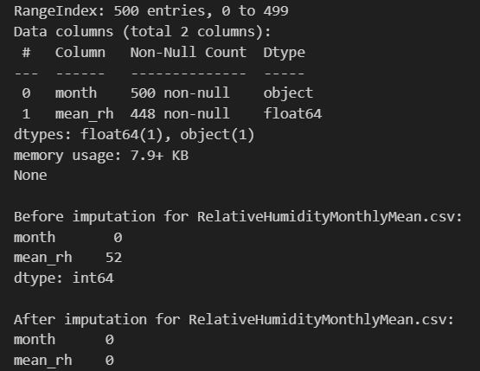
#2 DATA PROCESSING AND ANALYSING of RelativeHumidityMonthlyMean.csv
The DataFrame has 500 entries, ranging from 0 to 499. In the ‘month’ column there are 500 entries while in the ‘mean_rh’(mean_relative humidity) column there are only 448 entries which shows that there are 52 missing values.
Therefore, the function is put in place to handle missing data values with the mean (average) of the column.
It can be seen that after imputation, there are 0 missing values which shows that the dataset has also been successfully imputated.

Slide 11
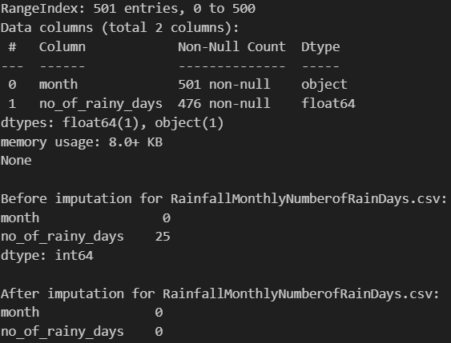
#3 DATA PROCESSING AND ANALYSING of A RainfallMonthlyNumberofRainDays.csv
The DataFrame has 501 entries, ranging from 0 to 500. the ‘month’ column has 501 entries but the ‘no_of_rainy_days’ column has 476 entries which implies that there are 25 missing values in the dataset.
Therefore, the function is put in place to handle missing data values with the mean (average) of the column.
It can be seen that after imputation, there are 0 missing values which shows that the dataset has also been successfully imputated.

Slide 12
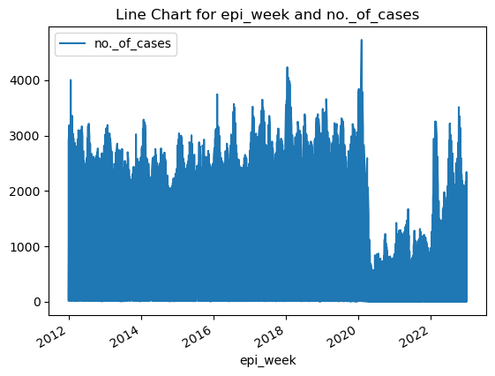
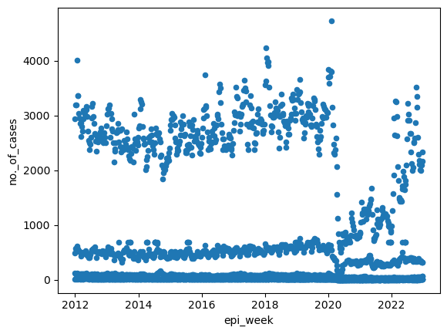
#1 dataset: AverageDailyPolyclinicAttendancesforSelectedDiseases.csv
The data is represented by a blue line showing fluctuations in case numbers over time from 2012 to 2022, with noticeable spikes around the years 2020 and 2022.
Most data points are clustered near the bottom of the graph until around 2020, where there’s a significant increase in case numbers. After 2020, the case numbers fluctuate between approximately 2000 and 4000. This suggests a noticeable increase in the number of cases around 2020.

Slide 13
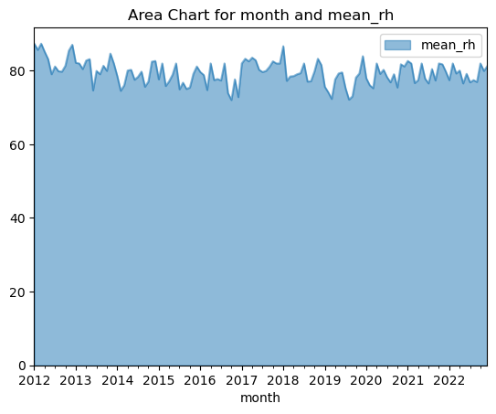
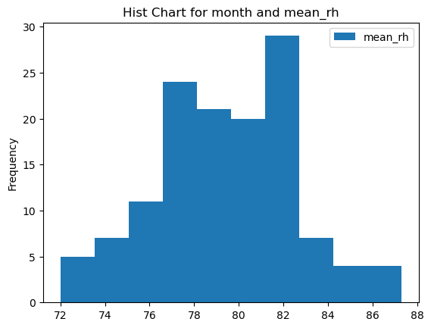
#2 dataset: RelativeHumidityMonthlyMean.csv
It represents the mean relative humidity (mean_rh) over a span of years from 2012 to 2022. The x-axis represents the years, and the y-axis represents the mean relative humidity, which ranges from 0 to 80. The light blue area under the line graph indicates the levels of mean_rh over time. The chart shows fluctuations in mean_rh, with visible peaks and troughs throughout the years.
The x-axis represents the mean relative humidity values, which range from 72 to 88.
The y-axis represents the frequency of each value, indicating how often each level of humidity occurs.
The blue bars represent the frequencies of different ranges of mean relative humidity. There are notable peaks around 76 and above 82

Slide 14
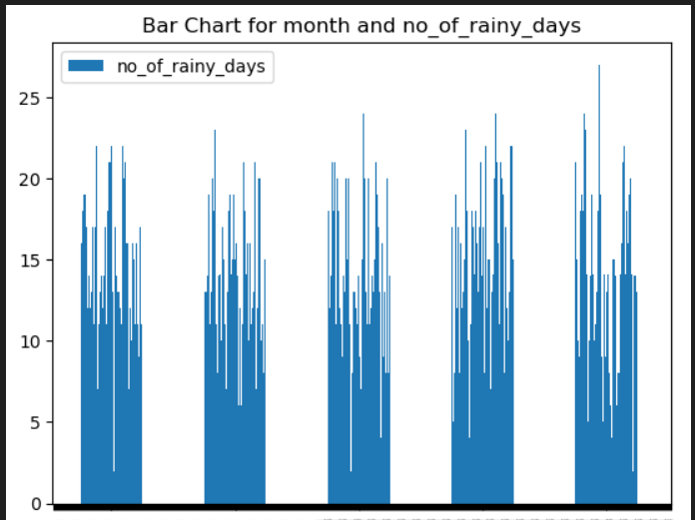
#3 dataset: RainfallMonthlyNumberofRainDays.csv
The x-axis can be seen from the year 2012 to 2022 The y-axis is labeled with numbers ranging from 0 to 25, indicating the count of rainy days in each month.
Each bar’s height indicates the number of rainy days in that specific month.
The color legend indicates that blue represents “no_of_rainy_days”.

Slide 15
Relationship between the three datasets
Based on the three we can obviously see that in 2020 when the rainfall and mean relative humidity is higher , there are more diseases in 2020 which shows that Humidity and rainfall actually does play a part.

Slide 16
Insights and solutions
Public Health Education:
Public Awareness Campaigns: Launch public awareness campaigns to educate the population about the potential health impacts of humidity and rainfall.
Preventive Measures: Provide information on preventive measures individuals can take during periods of high humidity or heavy rainfall.
Infrastructure and Urban Planning:
Mosquito Control Programs: Implement and strengthen mosquito control programs, especially during periods of increased rainfall, to prevent vector-borne diseases like dengue.
Urban Planning: Consider urban planning strategies that mitigate the impact of weather conditions on public health, such as proper drainage systems.
Healthcare Preparedness:
Capacity Planning: Ensure healthcare facilities are prepared for potential spikes in disease cases during periods of adverse weather conditions.
Stockpile Medications: Maintain adequate stocks of medications and medical supplies for diseases that may be influenced by weather conditions.

Slide 17

Thank You!
someone@example.com

